Slide 1
Wine Quality Prediction
Bijay Adhikari
Saurav Dahal

Slide 2
Introduction
Did you know that wine's acidity, sugar levels, and even pH determine its quality?
In fact, higher-quality wines often balance these elements perfectly, with just the right level of volatile acidity.
Using real-world data, we’ll explore how data science help us unravel what makes a great wine.

Slide 3
Why Wine Quality Analysis?
Ensures consistent quality for all.
Identifies key chemical factors influencing flavor.
Optimizes production for better outcomes.
Aligns quality with pricing strategies.
Provides data-driven insights on excellence.
Bridges taste and science seamlessly. 🍷
Notes:
Wine analysis is essential to ensure consistent quality for everyone, from the winemaker to the consumer.
It helps us uncover the key chemical factors—like acidity, sugar, and alcohol—that shape a wine’s flavor and balance.
By understanding these elements, winemakers can optimize their processes to produce even better results.
It also connects quality to pricing, helping the market value wines more accurately.
Most importantly, it provides data-driven insights into what makes a wine truly exceptional, bridging the gap between subjective taste and scientific understanding. In short, it’s how we bring together the art and science of wine.

Slide 4


Data Source and Features
1,599 observations
12 variables
The dataset is related to red and white variants of the Portuguese "Vinho Verde" wine.

Slide 5
12 Variables
fixed.acidity
chlorides
Acid content in the wine.
Salt content.
volatile.acidity
free.sulfur.dioxide
Volatile acid content.
free SO₂ in mg/L.
citric.acid
total.sulfur.dioxide
Citric acid concentration.
Total SO₂ in mg/L.
residual.sugar
density
Wine density.
Residual sugar in g/L.
sulphates
Sulphate concentration
pH
Acidity level.
quality
alcohol
Wine quality score
Alcohol percentage.

Slide 6
Data Characteristics:
quality
No missing values in the data set
It serves as the target, representing wine quality on a scale from 3 (low) to 8 (high).
Features represent continuous chemical measurements, suitable for regression or classification modeling.

Slide 7
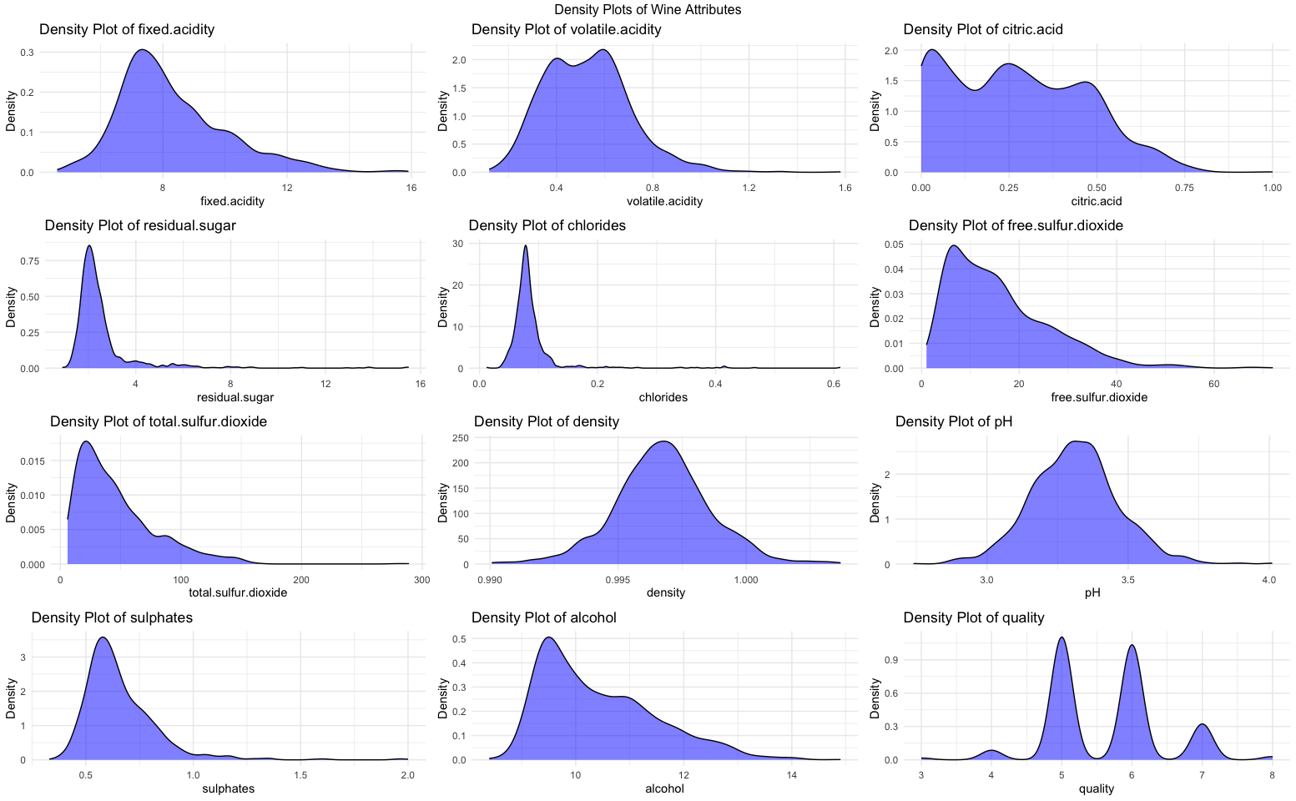
Density Plots of Wine Attributes

Slide 8
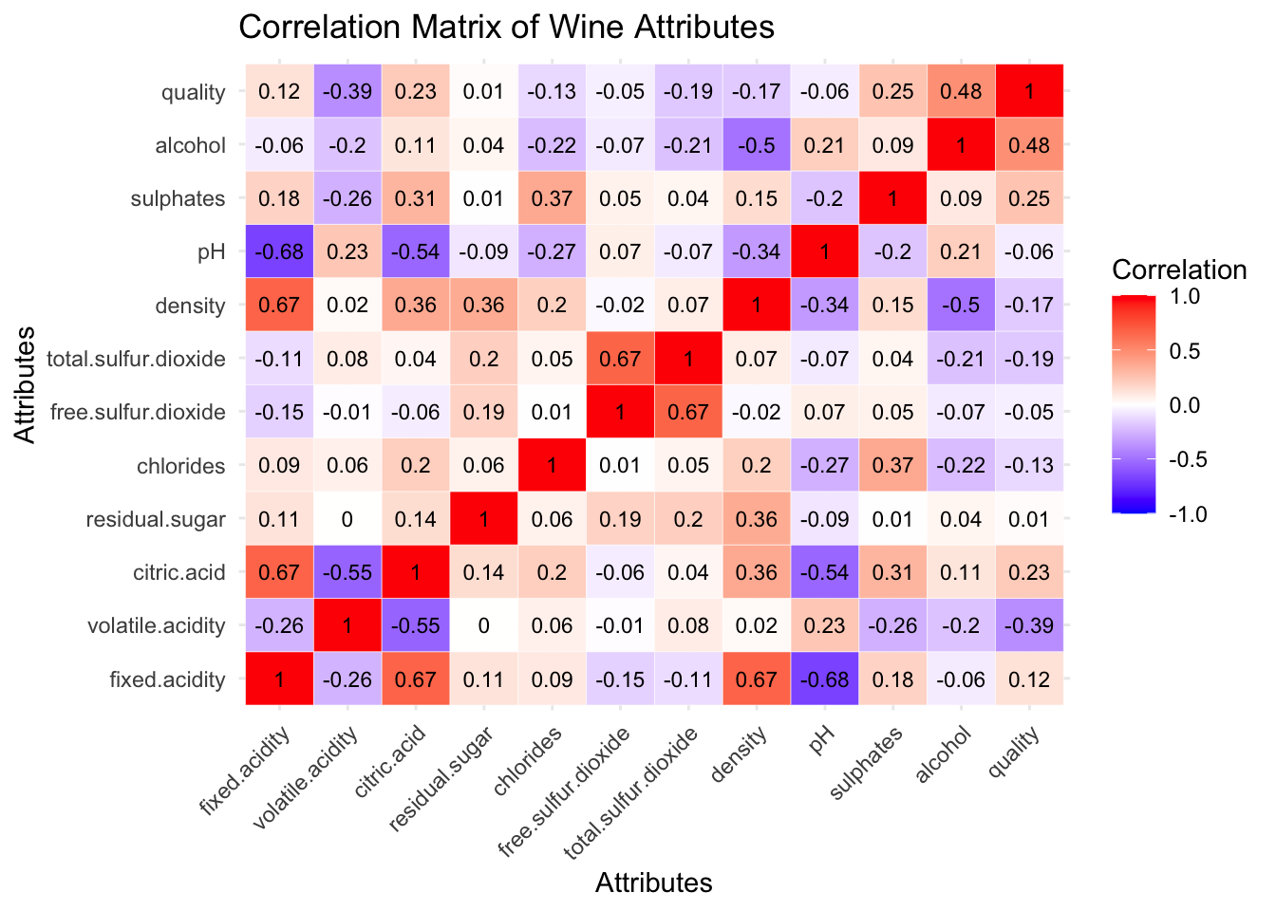
Correlation Matrix of Wine Attributes

Slide 9
Research Questions
Can logistic regression accurately classify wine quality (e.g., high vs. low) based on chemical attributes?
Which chemical attributes (e.g., alcohol content, acidity) are the most significant predictors of wine quality?
01
02
How can K-means clustering help identify distinct segments or groups of wines with similar chemical profiles?
How Can the Predictive Model Assist Wineries in Quality Control and Decision-Making?
03
04

Slide 10
Q1. Can logistic regression accurately classify wine quality (e.g., high vs. low) based on chemical attributes?
Q2. Which chemical attributes (e.g., alcohol content, acidity) are the most significant predictors of wine quality?

Slide 11
Most Significant Predictors of Wine Quality
1
2
3
Alcohol
Volatile Acidity
Sulphates
Positive impact on quality (strongest predictor, p < 0.001)
Negative impact on quality (p < 0.001)
Positive impact on quality (p < 0.001)
4
5
6
Total Sulfur Dioxide
Chlorides
Free Sulfur Dioxide
Negative impact on quality (p < 0.001)
Negative impact on quality (p < 0.05)
Positive impact on quality (p < 0.05)

Slide 12
Logistic Regression Model Evaluation
Accuracy: 73.75%
Sensitivity (True Positive Rate): 77.50%
The model correctly identifies 77.5% of “low quality” wines.
Specificity (True Negative Rate): 70.00%
The model correctly identifies 70.0% of “high quality” wines.
Interpretation of Sensitivity vs. Specificity
Sensitivity (77.50%) is higher than Specificity (70.00%):
The model is better at identifying “low quality” wines compared to “high quality” wines.
Given the balanced accuracy (73.75%), the model performs reasonably well but could be improved with further feature selection or tuning.
Notes:
Importance:
Sensitivity: Crucial for quality control (avoiding low-quality wines being misclassified as high-quality).
Specificity: Important for marketing high-quality wines (ensuring high-quality wines are correctly identified).
Based on the logistic regression summary and model evaluation, the model demonstrates a reasonable ability to classify wine quality (high vs. low) based on chemical attributes. The overall accuracy is 73.75%, indicating that approximately 74% of predictions are correct. The model shows higher performance in identifying “low quality” wines, with a Sensitivity of 77.50%, compared to identifying “high quality” wines, with a Specificity of 70.00%.
Significant predictors of wine quality include alcohol, volatile acidity, sulphates, total sulfur dioxide, and chlorides, which strongly influence the binary classification. These attributes highlight the chemical characteristics most associated with high or low wine quality, demonstrating the model’s ability to leverage meaningful features.
While the model achieves a good balance between sensitivity and specificity, it performs better at detecting “low quality” wines, which is beneficial for quality control processes. However, the slightly lower specificity indicates room for improvement in correctly identifying “high quality” wines. Additional feature engineering or model tuning could enhance accuracy and specificity.
In conclusion, logistic regression can reasonably classify wine quality with a balanced accuracy of 73.75%, leveraging key chemical attributes. While the current model is effective, further refinements could improve its classification performance, particularly for high-quality wines.

Slide 13
3. How can K-means clustering help identify distinct segments or groups of wines with similar chemical profiles?

Slide 14
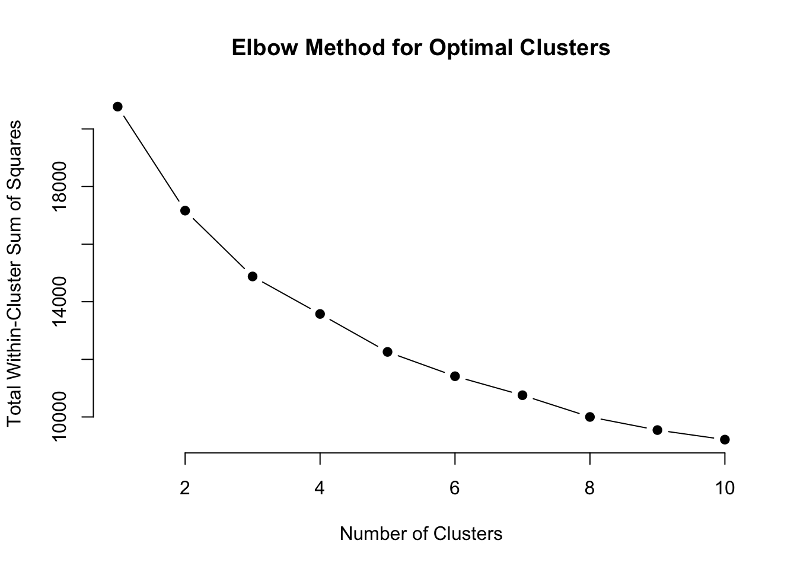
Elbow Method for finding the cluster size

Slide 15
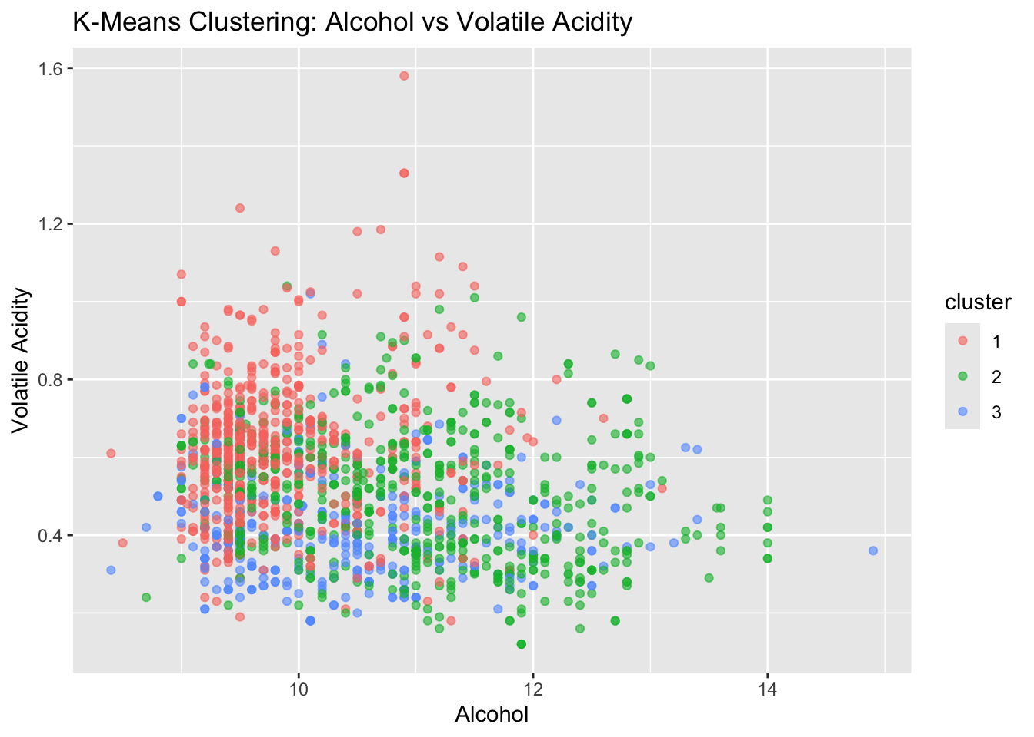
K-means Clustering
Notes:
K-means clustering helps identify distinct segments of wines with similar chemical profiles by grouping them based on **alcohol content** and **volatile acidity**, as shown in the graph:
- **Cluster 1 (Red)**: Wines with **low alcohol content** (9–11%) and **high volatile acidity** (above 0.7). These are likely lower-quality wines due to unfavorable chemical profiles.
- **Cluster 2 (Green)**: Wines with **moderate alcohol content** (10–12%) and **moderate volatile acidity** (0.4–0.8). These wines represent a balanced segment, likely of average quality.
- **Cluster 3 (Blue)**: Wines with **high alcohol content** (12–14%) and **low volatile acidity** (below 0.6). These wines have desirable profiles, associated with higher quality.

Slide 16
4. How Can the Predictive Model Assist Wineries in Quality Control and Decision-Making?

Slide 17
Quality Control
Segmenting Wines
High sensitivity (77.50%) ensures effective identification of low-quality wines for intervention.
Cluster 1: Likely lower-quality wines.
Cluster 2: Balanced, average-quality wines.
Cluster 3: Higher-quality wines.
Helps in targeting specific markets and creating tailored blends.
Identifying Key Drivers
Market Strategy
Significant predictors like alcohol, volatile acidity, sulphates, chlorides, and total sulfur dioxide guide production adjustments to improve quality.
Insights on chemical profiles enable better positioning of premium wines and alignment with consumer preferences.

Slide 18
Thank You

